Slide 1
Projet fil rouge Sang-thétique
Léa CASAGRANDE
Développeur web et web mobile
ADRAR 2022-2023

Slide 2
Sommaire
01
03
Cahier des charges
HTML-CSS
02
Analyse fonctionnelle - UML

Slide 3
01
Cahier des charges

Slide 4
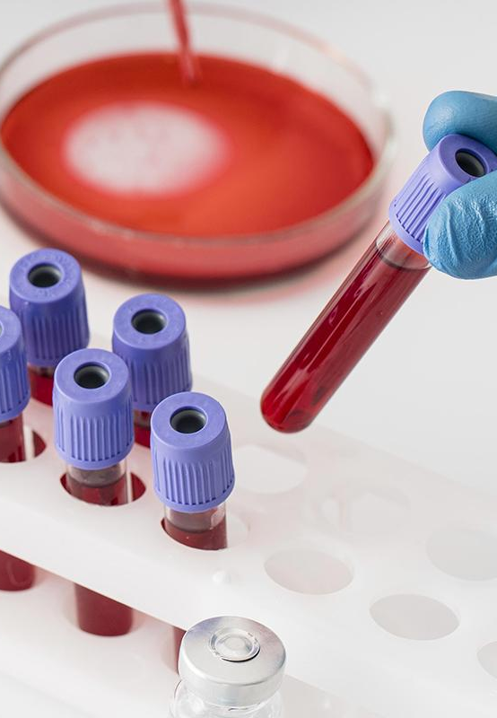
Présentation du projet
Sang-thétique est un laboratoire fictif de recherche en biologie humaine.
→ site vitrine
Activités du laboratoire
Equipes et personnels
Partenaires

Slide 5
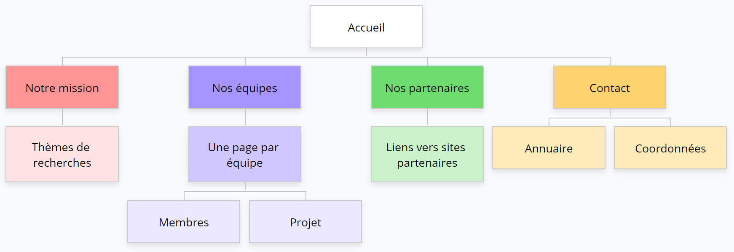
A. Arborescence

Slide 6
02
Analyse fonctionnelle - UML

Slide 7
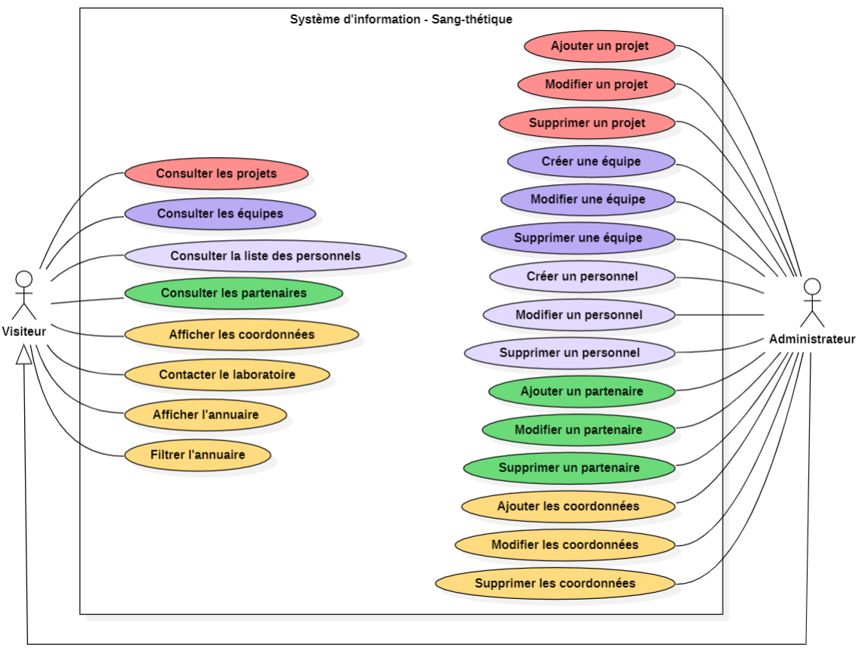
A. Cas d’utilisation – USE CASE

Slide 8
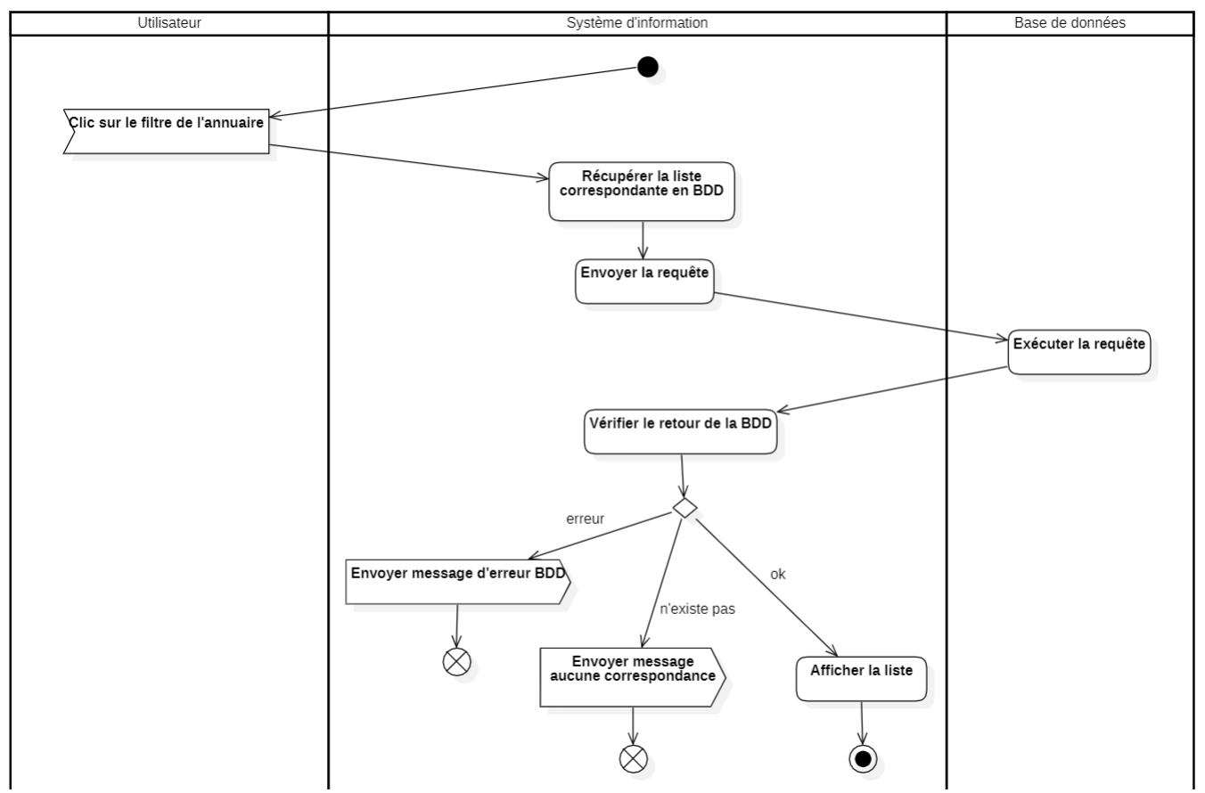
B. Diagramme d’activité – Filtrer les personnels dans l’annuaire

Slide 9
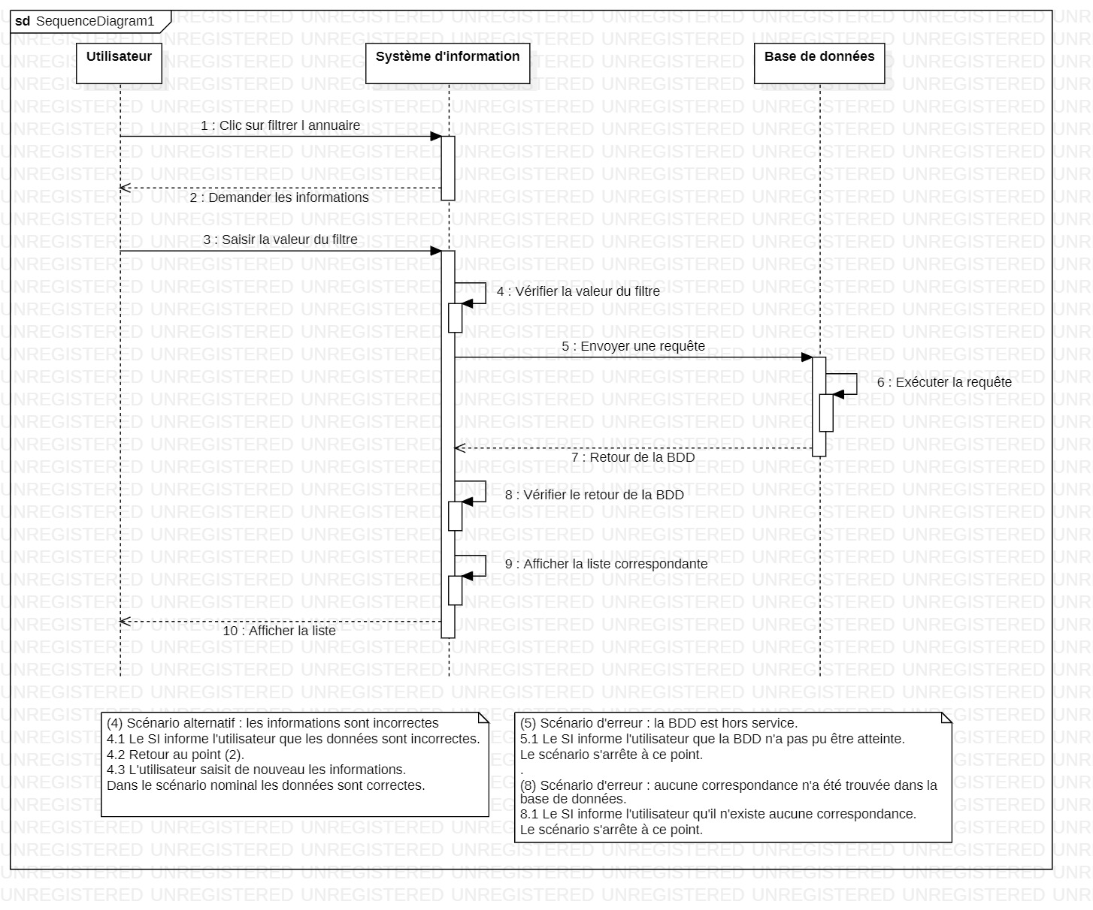
C. Diagramme de séquence – Filtrer les personnels dans l’annuaire

Slide 10
03
HTML - CSS

Slide 11
A. Cahier des charges
Here’s what you’ll find in this Slidesgo template:
A slide structure based on a presentation about a disease, which you can easily adapt to your needs. For more info on how to edit the template, please visit Slidesgo School or read our FAQs.
An assortment of graphic resources that are suitable for use in the presentation can be found in the alternative resources slide.
A thanks slide, which you must keep so that proper credits for our design are given.
A resources slide, where you’ll find links to all the elements used in the template.
Instructions for use.
Final slides with:
The fonts and colors used in the template.
A selection of illustrations. You can also customize and animate them as you wish with the online editor. Visit Storyset to find more.
More infographic resources, whose size and color can be edited.
Sets of customizable icons of the following themes: general, business, avatar, creative process, education, help & support, medical, nature, performing arts, SEO & marketing, and teamwork.
You can delete this slide when you’re done editing the presentation.

Slide 12
Awesome Words

Slide 13
About anemia
Anemia
Infections
Pains
Venus is the second planet from the Sun
Saturn is a gas giant and has several rings
It’s the biggest planet in the Solar System

Slide 14
About anemia
Fever
Sight
It’s the second planet from the Sun
It’s the biggest planet of them all
Swelling
Pale Skin
Despite being red, Mars is a cold place
It’s a gas giant and has several rings

Slide 15
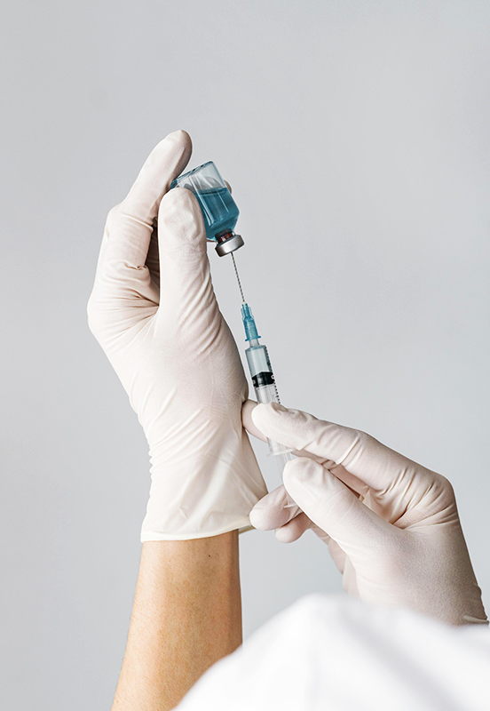
Concepts and
typology
Type A
Type B
Despite being red, Mars is a cold place
It’s a gas giant and has several rings

Slide 16
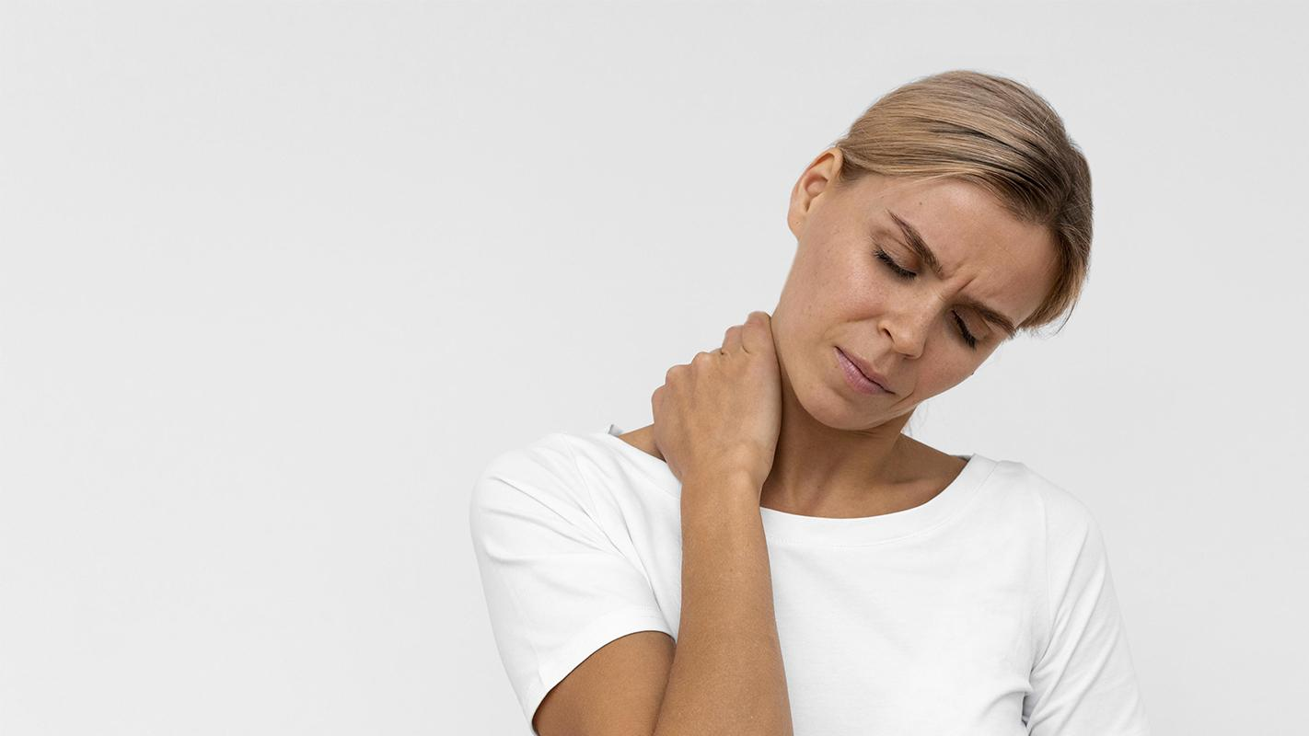
A picture is worth a thousand words

Slide 17
Pathology
Intense pain
Yellowish color
Swollen hands
Stunted growth
Despite being red, Mars is a cold place
Neptune is the farthest from the Sun
Saturn is a gas giant and has several rings
Venus is the second planet from the Sun

Slide 18
Symptoms of sickle cell anemia
Accelerated
Dizziness
It’s the closest planet to the Sun and the smallest
Venus is the second planet from the Sun
Fatigue
Swollen hand
Saturn is a gas giant and has several rings
Neptune is the farthest from the Sun
Distracted
Irritable
Earth is the third planet from the Sun
Despite being red, Mars is a cold place

Slide 19
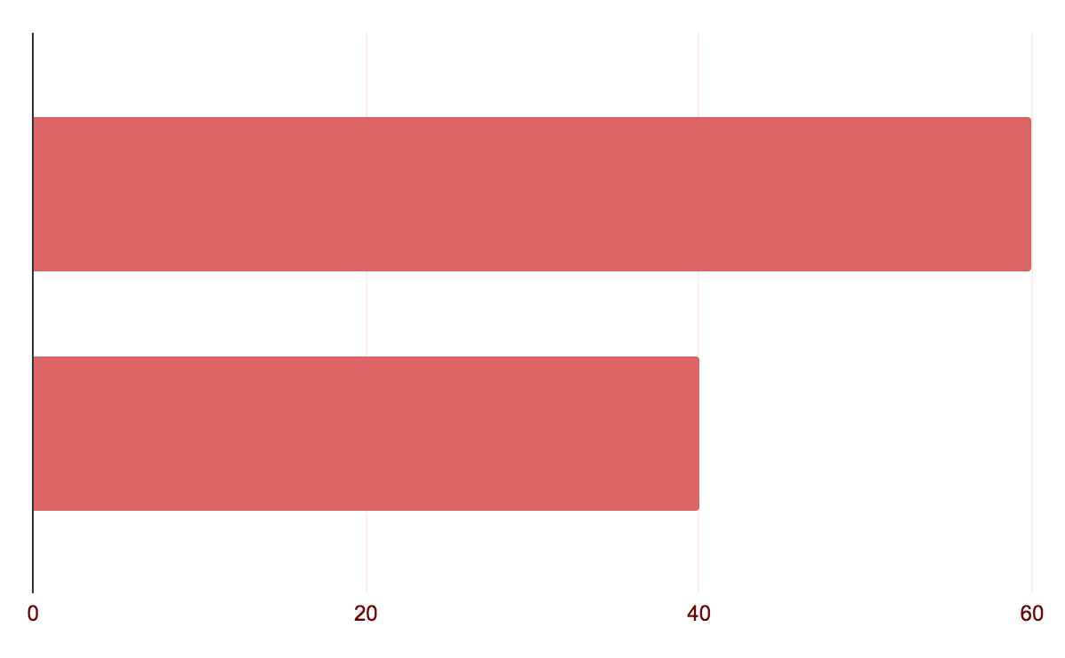
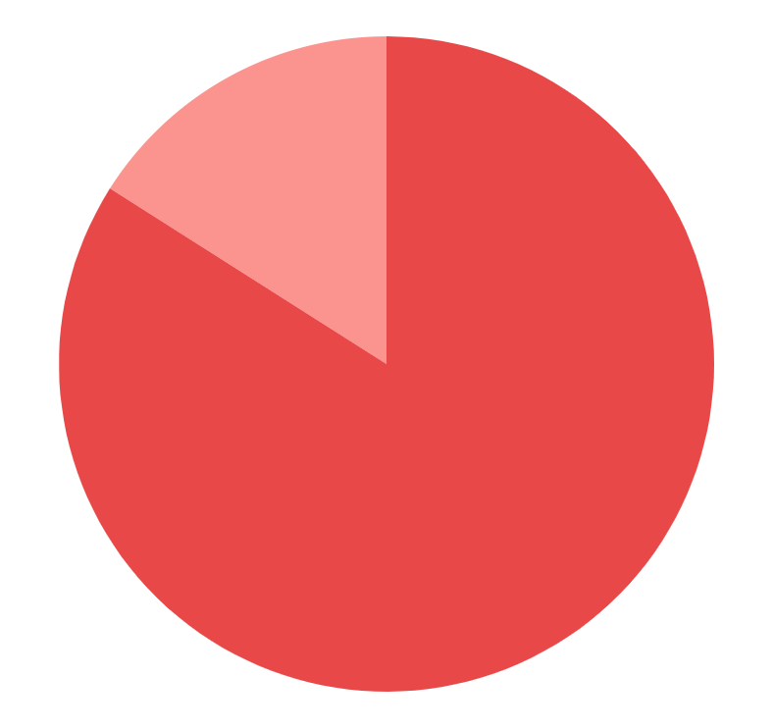
Risks factors
Age
Gender
0-5
16%
10-25
84%
60%
Female
40%
Male
Follow the link in the graph to modify its data and then paste the new one here. For more info, click here

Slide 20
2000
The Spanish Society of Pediatric Hematology has kept records of patients who suffer from it since 2000

Slide 21
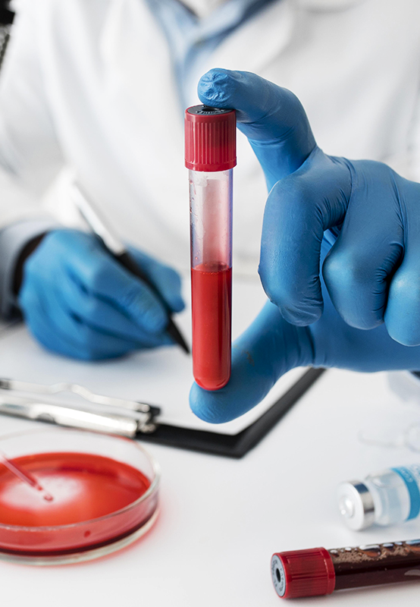
Key numbers
50,000
20,000
10,000
It’s the closest planet to the Sun and the smallest
Earth is the third planet from the Sun
Saturn is a gas giant and has several rings

Slide 22
—Someone Famous
“This is a quote, words full of wisdom that someone important said and can make the reader get inspired”

Slide 23
Diagnosis
Mercury
Venus
Mars
Saturn
Jupiter
Neptune
Mercury is the closest planet to the Sun
Venus is the second planet from the Sun
Despite being red, Mars is a cold place
Saturn is a gas giant and has several rings
It’s the biggest planet in the Solar System
Neptune is the farthest from the Sun

Slide 24
Prevention
Folic acid | Much water | Do sport
It’s the closest planet to the Sun | It has very high temperatures | Mars is actually a very cold place
It’s the smallest planet of them all | Venus has a beautiful name | Mars it's full of iron oxide dust

Slide 25
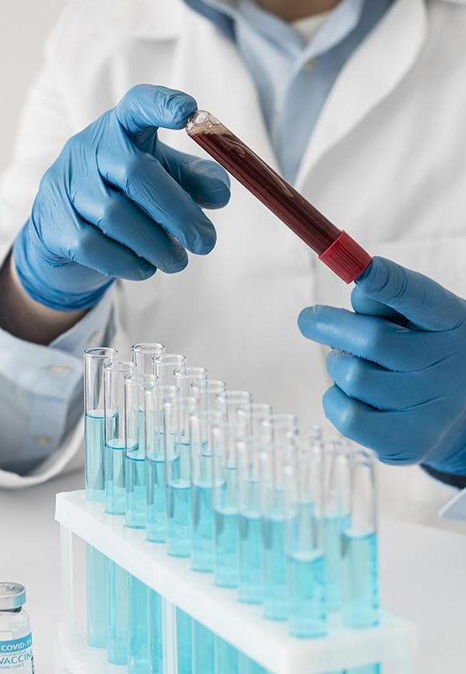
A picture
always reinforces the concept
Images reveal large amounts of data, so remember: use an image instead of a long text

Slide 26
Treatment
Medicines
Surgeries
Venus has a beautiful name and is the second planet from the Sun
It’s the closest planet to the Sun and the smallest one in the Solar System

Slide 27
Timeline
1
2
3
Venus
Jupiter
Saturn
Venus is the second planet from the Sun
Jupiter is the biggest planet in the Solar System
Saturn is a gas giant and has several rings

Slide 28
Recommendations
Don'ts
Do
Here you can describe what the patient shouldn’t do
Here you can describe what the patient shouldn’t do
Here you can describe what the patient shouldn’t do
Here you can describe what the patient shouldn’t do
Here you can describe what the patient should do
Here you can describe what the patient should do
Here you can describe what the patient should do
Here you can describe what the patient should do

Slide 29
Prevalence
Neptune
Neptune is the farthest from the Sun
Jupiter
It’s the biggest planet
in the Solar System

Slide 30
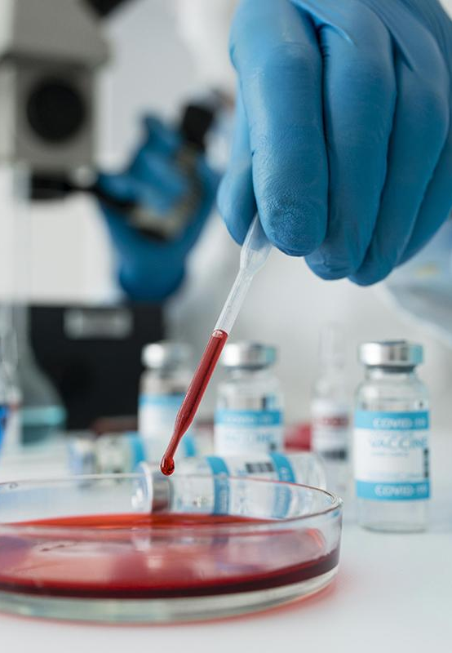
Conclusions
Mercury is the closest planet to the Sun and the smallest one in the Solar System—it’s only a bit larger than the Moon

Slide 31
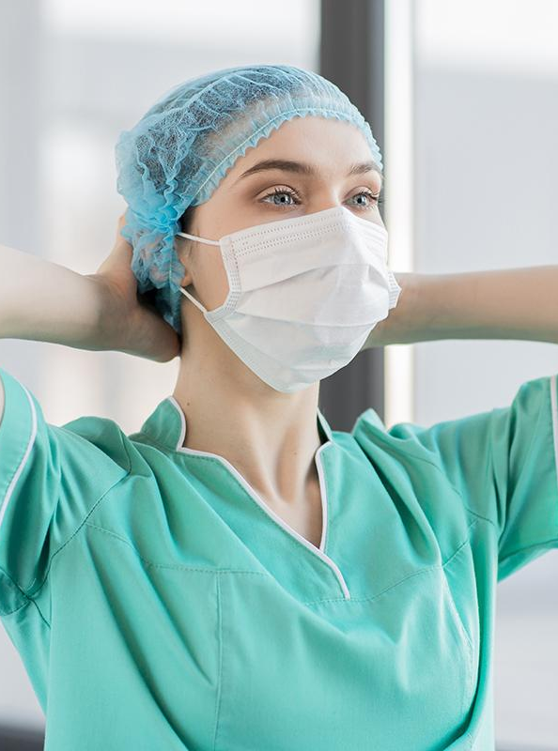
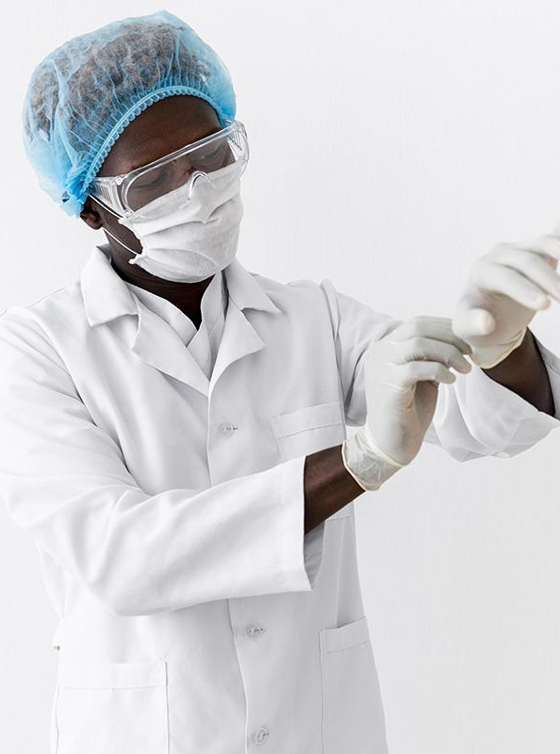
Our team
Jenna Doe
John James
You can replace the image on the screen with your own
You can replace the image on the screen with your own

Slide 32
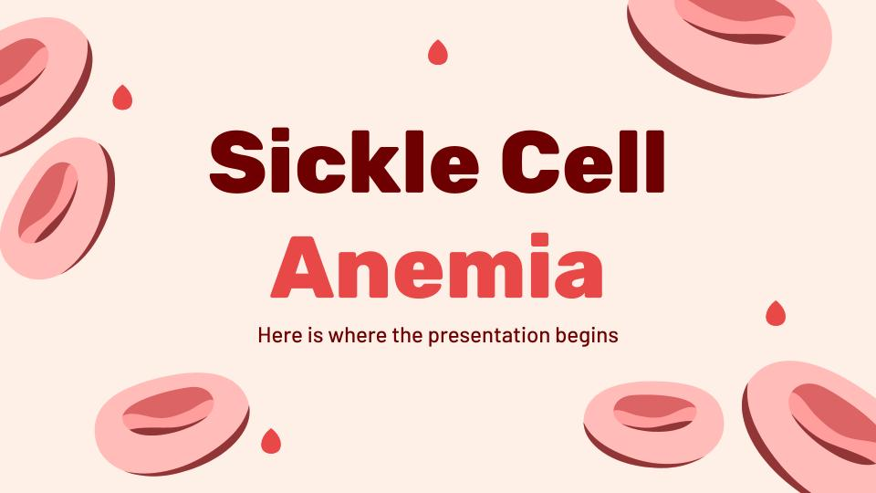
Desktop app
You can replace the image on the screen with your own work. Just right-click on it and select “Replace image”

Slide 33
Thanks
Do you have any questions?
addyouremail@freepik.com | +91 620 421 838 | yourcompany.com
Please keep this slide for the attribution

Slide 34
Fonts & colors used
This presentation has been made using the following fonts:
Rubik
(https://fonts.google.com/specimen/Rubik)
Barlow
(https://fonts.google.com/specimen/Barlow)
#6e0001
#ffffff
#fff0e7
#fb948e
#e84847
#ad2223
#ffbcb9
#dd6465
#923536
#ff9e9d

